Slide 1


Surveying for native plant allelopathy:
lettuce seed bioassay, seedling growth, and aqueous extract properties
Emily Mullins

Slide 2
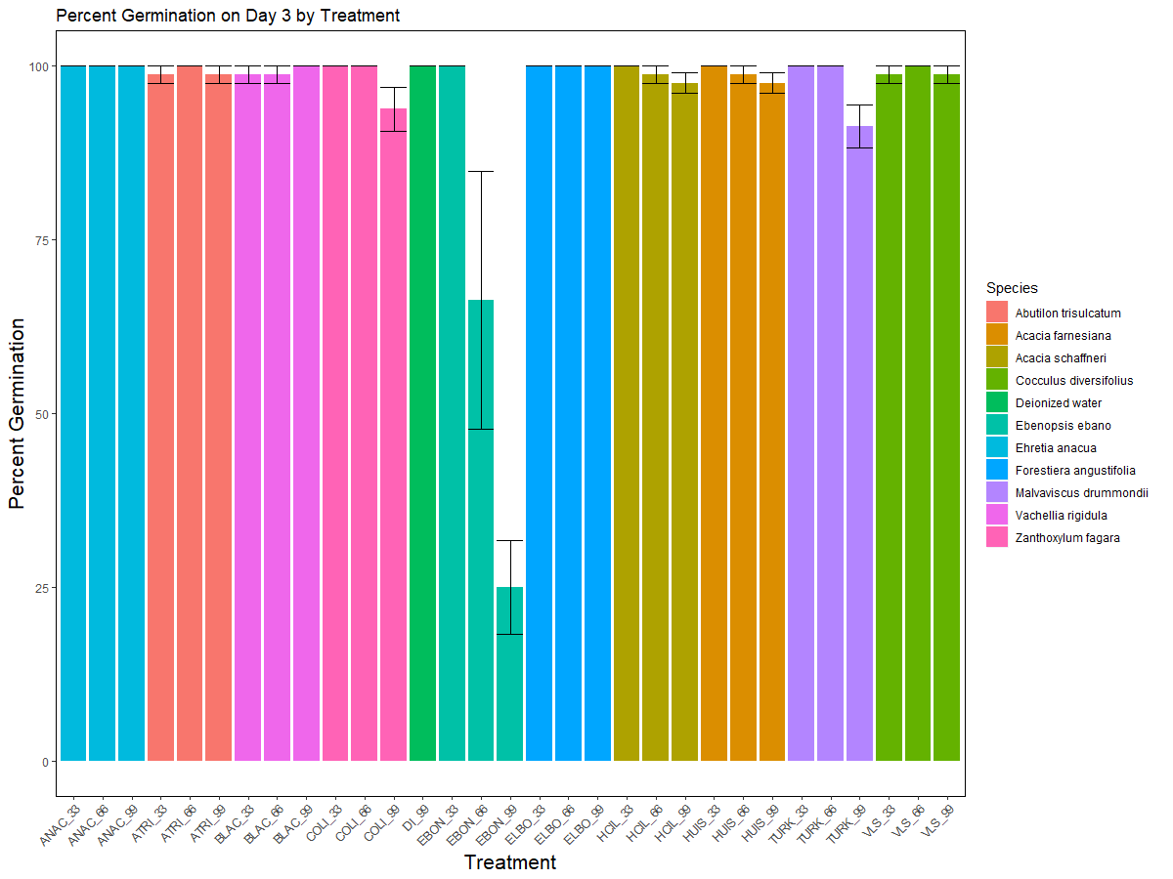
There are several ways to look at effects on germination
Percent germination:
This measure shows how many of the seeds
germinated in the designated time frame
I used three days because lettuce germinates
very rapidly and three day is the typical
amount of time used in the literature
Ebanopsis ebano has the greatest impact on
percent germination
At the highest concentration, M. drummondi,
Z. fagara, A. Schaffneri, A. Farnesiana, and
A. trisulcatum all reduce germination

Slide 3
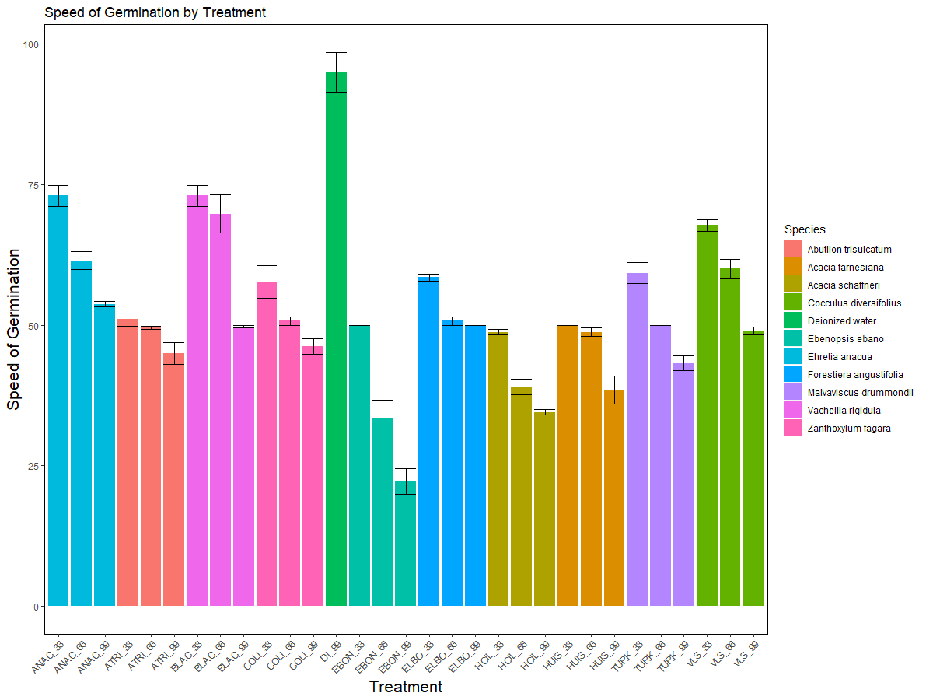
Speed of Germination:
All treatments reduced the speed of germination as compared to the control
E. ebano had the greatest impact on germination speed
A. schaffneri, A. farnesiana, and A. trisulcatum were other species that impacted germination speed
*Another common method used is mean germination time

Slide 4
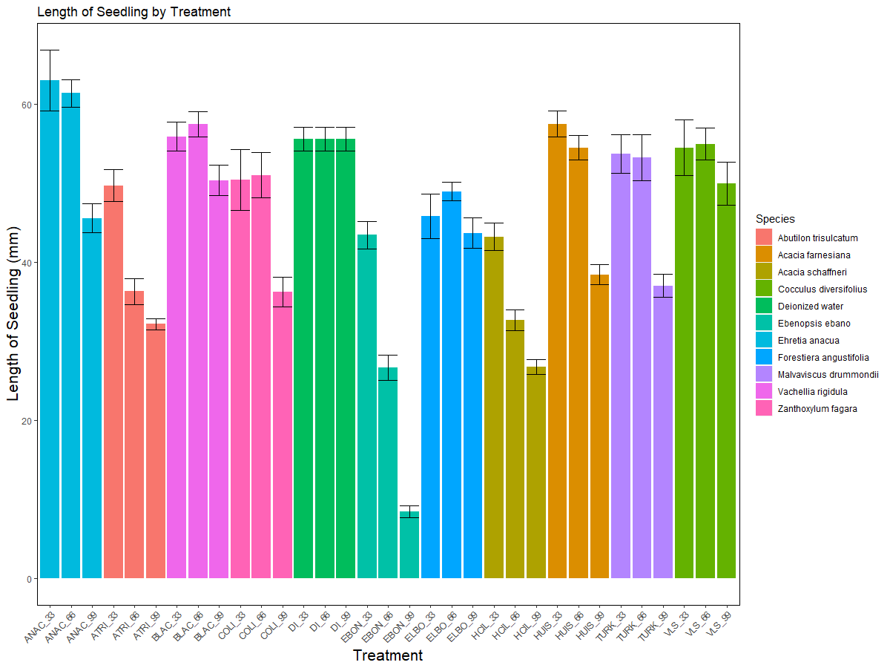
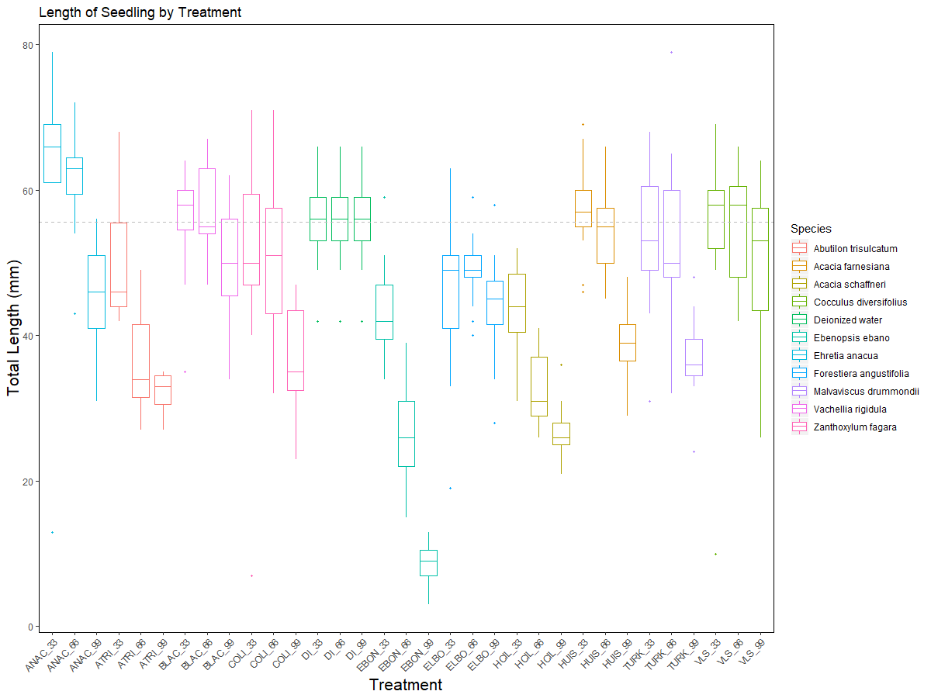
Seedling Length at Day 5
At lower concentrations, E. anacua actually increased seedling growth
Again E. ebano has the greatest impact followed by A. Schaffneri, A. trisulcatum, Z. fagara, M. drummondi, and A. Farnesiana

Slide 5
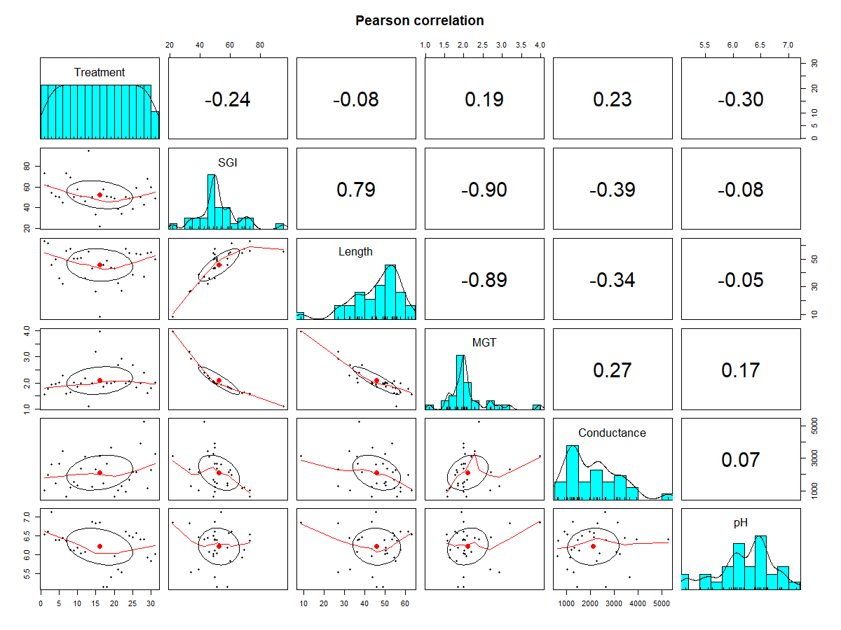
Combining multiple data sets to test correlation
pH<- read.csv("C:/Users/emull/OneDrive/Documents/UTRGV/Grad Research/pH_cond.csv", header=TRUE)
pH$pH <- as.character(pH$pH)
pH$pH <- as.numeric(pH$pH)
pH$cond <-as.character(pH$cond)
pH$cond <-as.numeric(pH$cond)
bio2 <- merge(bio, pH, by = "Treatment", all.x = TRUE)
length<- read.csv("C:/Users/emull/OneDrive/Documents/UTRGV/Grad Research/lettucelength.csv", header=TRUE)
names(length)[names(length) == "ï..Treatment"] <- "Treatment"
bio3 <- merge(bio2, length, by = "Treatment", all.x = TRUE)

Slide 6
Conclusion :
Several species are potentially allelopathic
Texas Ebony (E. ebano)
Huisachillo (A. schaffneri)
Huisache (A. farnesiana)
Three Furrowed Indian Mallow (A. trisulcatum)
Turk’s Cap (M. drummondi)
Colima (Z. fagara)
Follow up testing to establish allelopathy
will include:
Mulch tests
High density seeding
Root staining for AMF infection
Pot experiments to assess impacts to
biomass accumulation and survival

